Slide 1
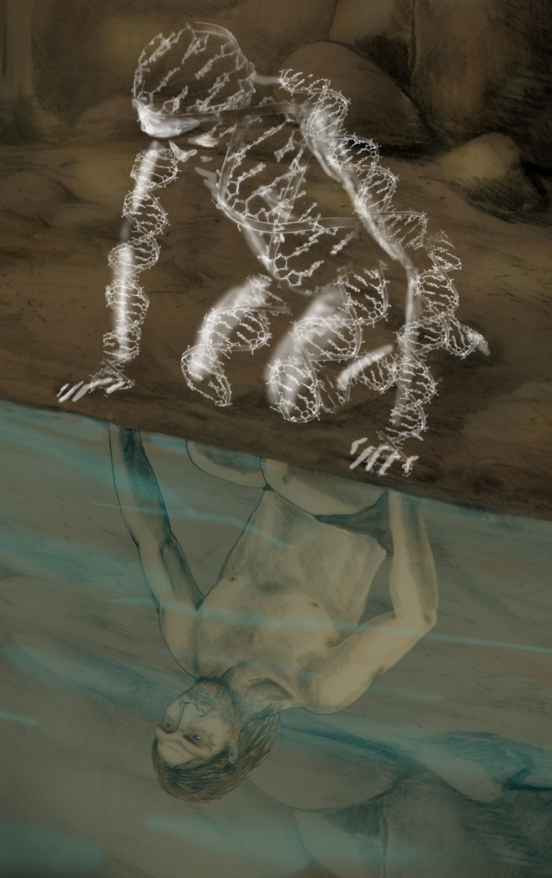
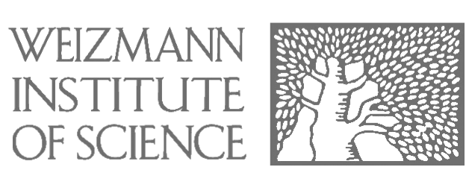
How diseases
emerge
disappear
and
Evolution
in
David Gokhman

Slide 2
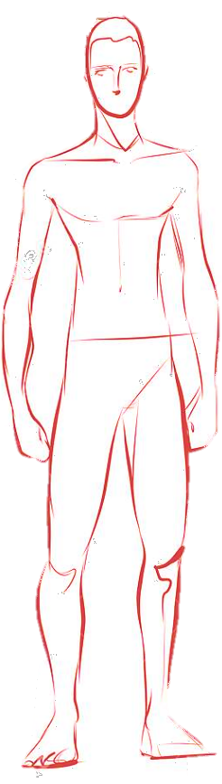
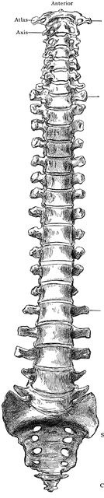
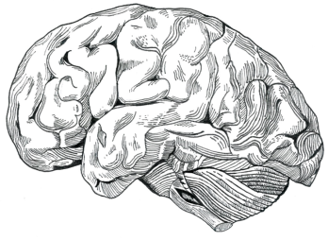
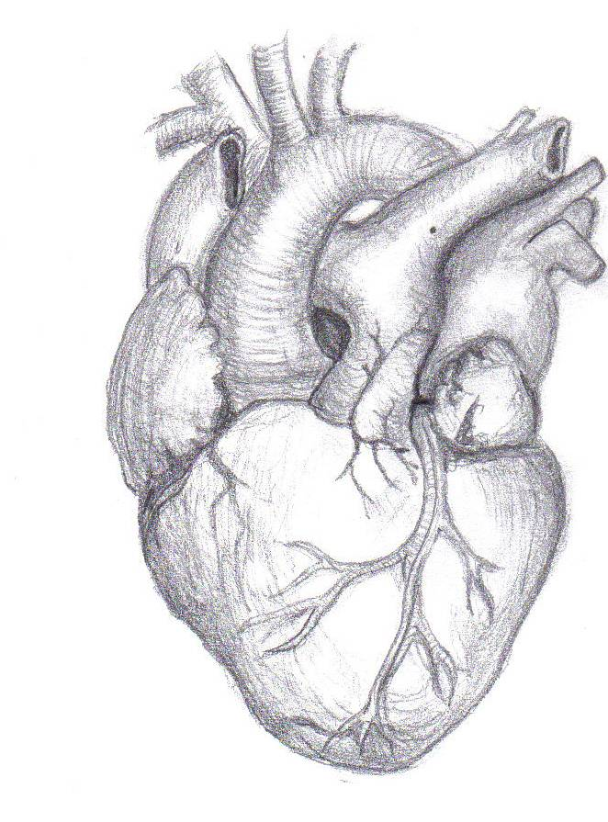

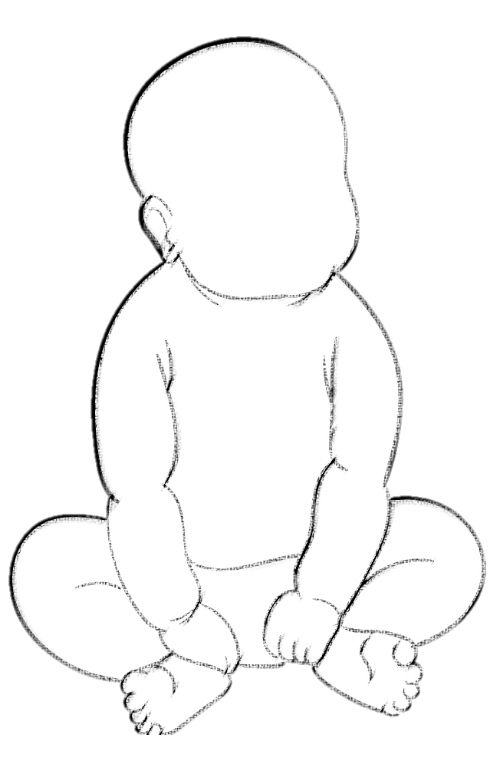
3x Brain
Upright walking
Alzheimer's disease
Schizophrenia
Chronic back pain
Disk hernia
Endurance
Extended
running
learning period
Preterm labor
Preeclampsia
Myocardial infarction
Notes:
Humans have evolved many exceptional adaptations, including our increased brain size, upright walking, adaptation to endurance running, and extended learning period.
At the same time, these adaptations also came with a high price tag - many disorders that are prevalent in humans, but uncommon or even nonexistent in other great apes.

Slide 3
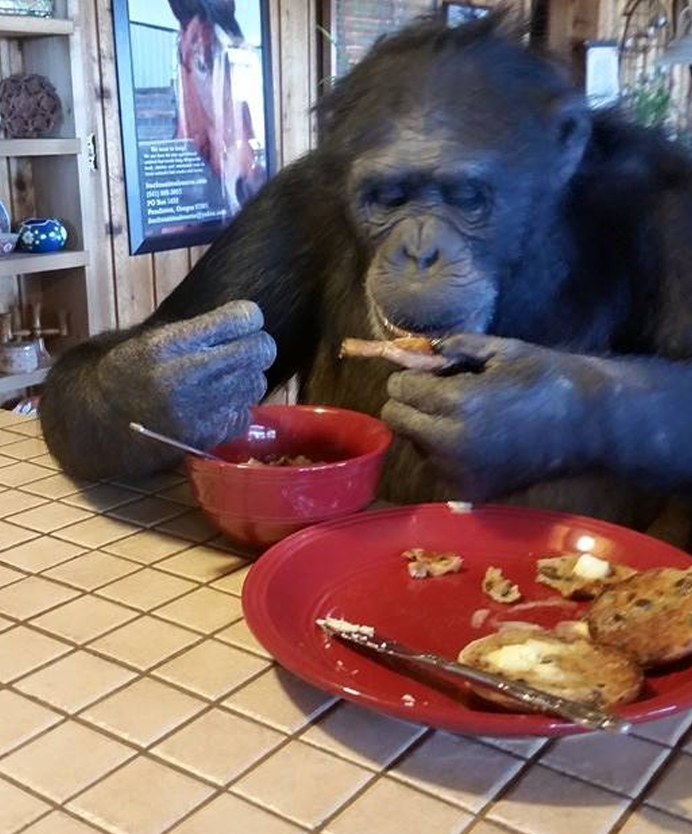
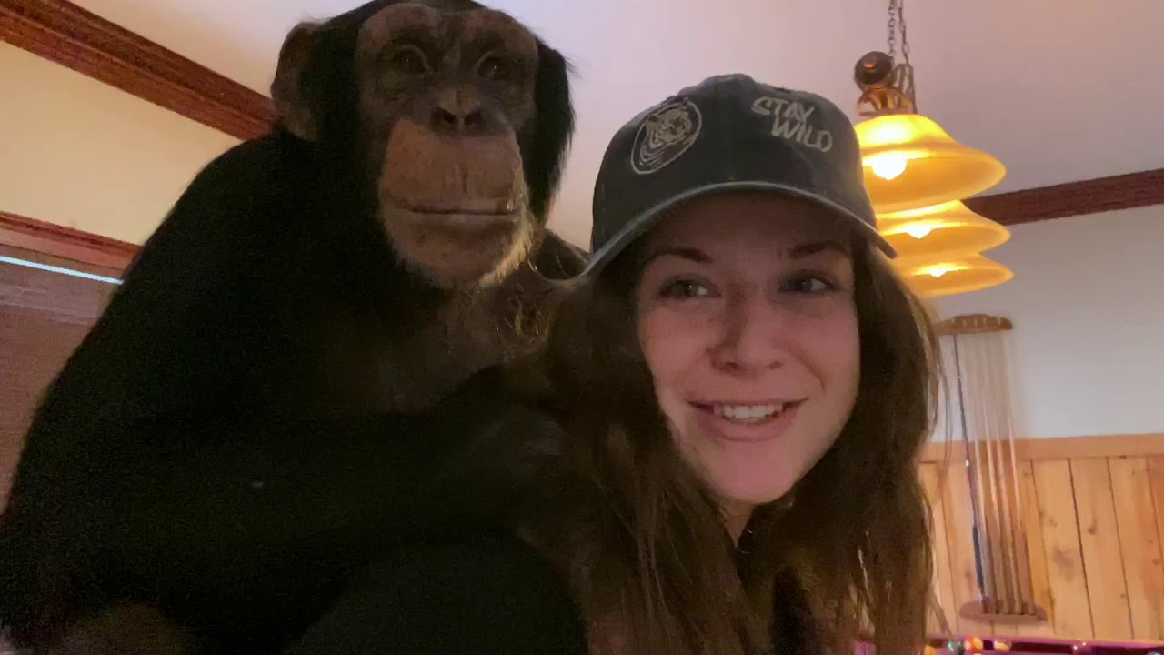
Human susceptibility is not explained by environmental differences
1
2
3
Why only humans?
Protection in
other apes
Cure
Genetic changes → human susceptibility
X
X
X
Environment
Longevity
Lack of data
Notes:
You might be thinking at this point that maybe these diseases are not really human-specific, but are just caused by our unique environment, diet, longevity, but actually, there are hundreds of apes that have been raised with humans practically as members of the family, eating human food, being exposed to urban toxins, living to the age of 60 or more, interacting with human pathogens, going through autopsy after death to identify cause of death – none of them get these diseases.
This suggests that these are indeed human-specific diseases and that genetic changes that emerged in our evolution have made us more susceptible to them
Our goal in this project is to try and understand why do only humans get these diseases, what is the mechanism that protects other apes from getting the disease, and if we find such mechanisms, can these protection mechanisms inform us in the development of a cure for the disease? After all, nature has already solved this problem for apes, so why not use it?

Slide 4


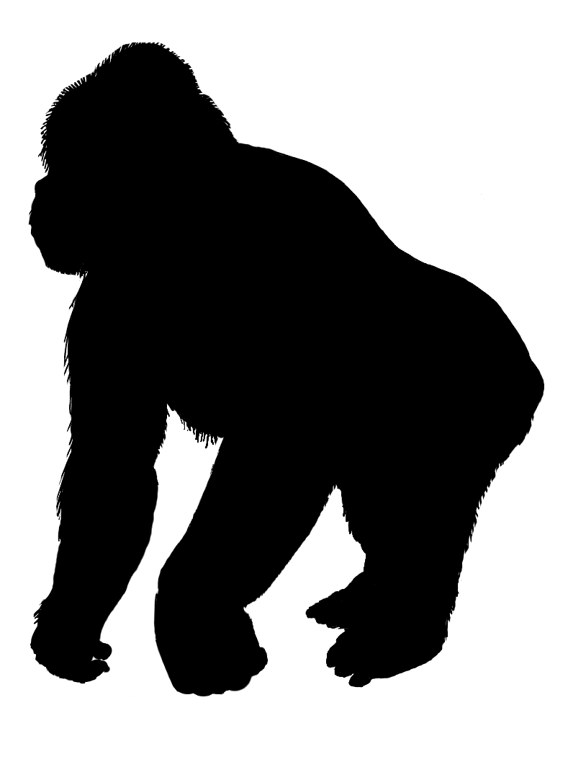
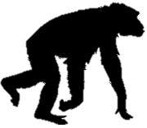
The emergence of human-specific diseases
Protected
Protected
Protected
Susceptible
Orangutan
Gorilla
Chimp
Human
Disease emerges
How did these changes emerge and spread? and Why?
The immediate suspect: changes to gene regulation
Notes:
The fact that genetic changes that make us more susceptible to a disease emerged in our evolution and spread in the human population is counterintuitive, as we would expect negative selection to purge these disease susceptibility alleles.
The question is how did these changes emerge, and what drove them?
The immediate suspect is changes to gene regulation, meaning changes to where, when and to what extent a gene is expressed. This is because changes to gene regulation are considered the main fuel of evolution.

Slide 5
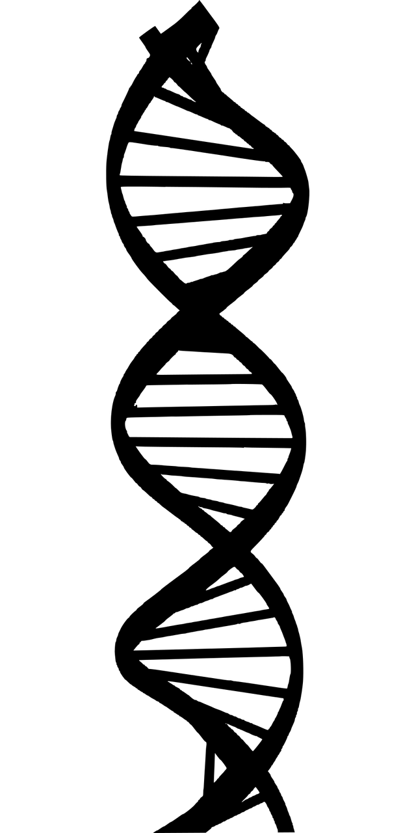



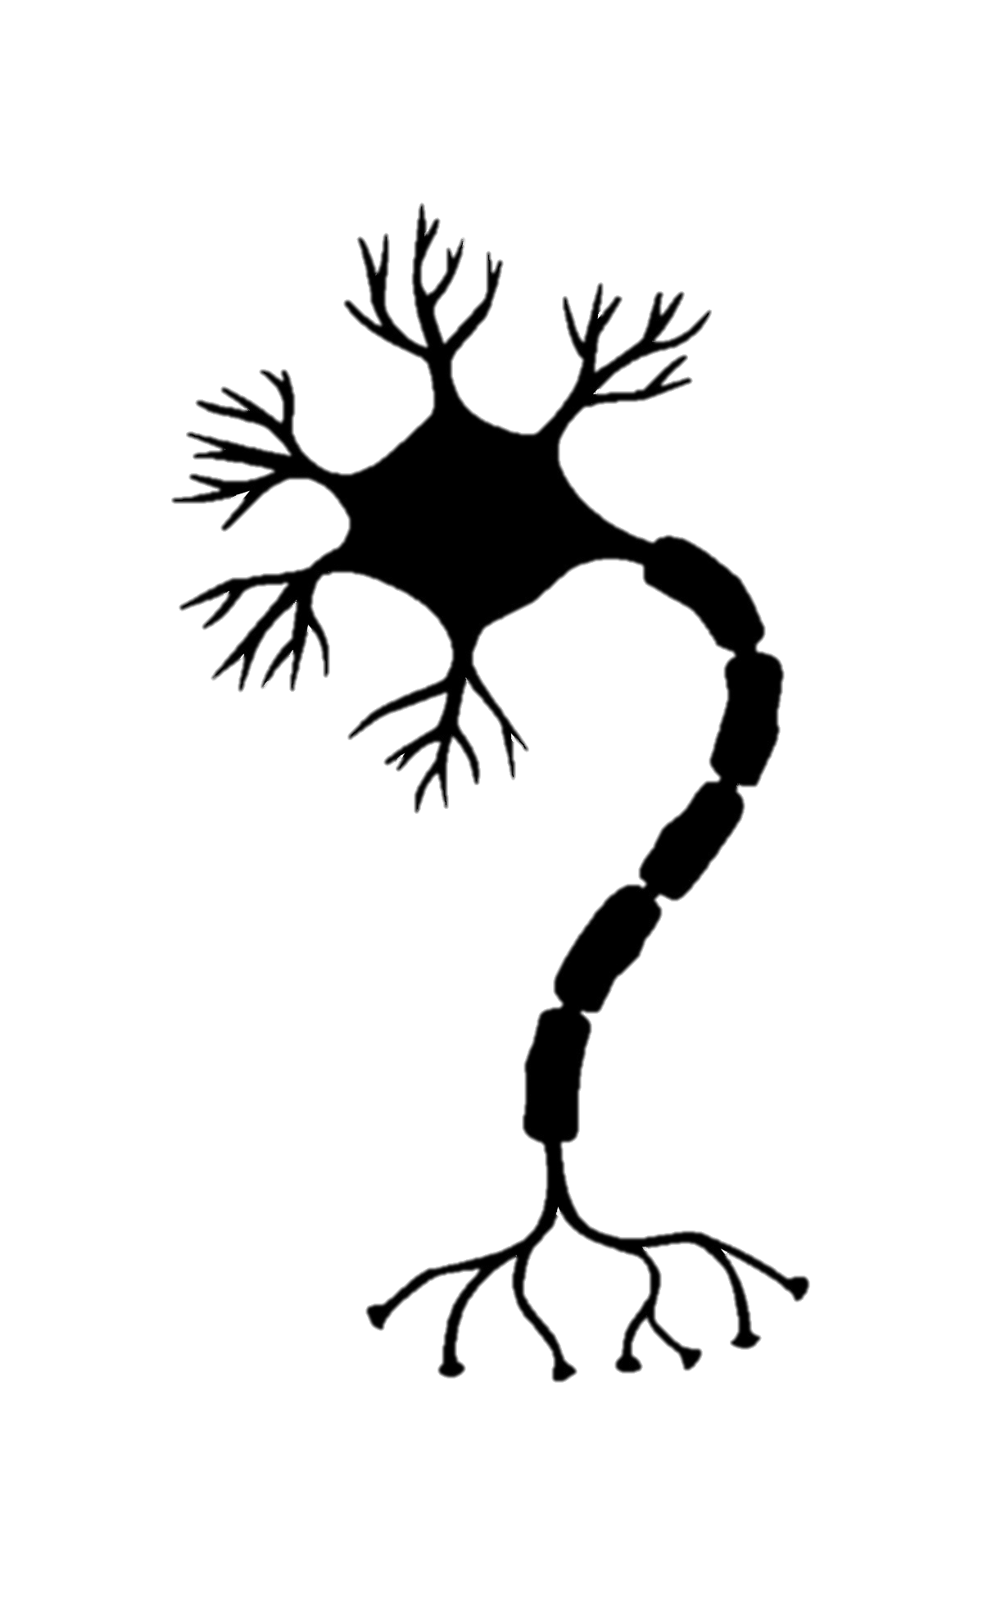
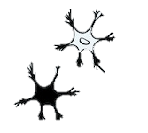

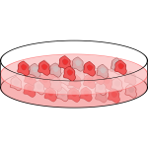
Changes to gene regulation – the main driver of evolution
Evolution
RNA
RNA
Confounders
Environment
Cell-type heterogeneity
Batch
Notes:
To find such changes, we can compare gene expression in a human sample to a chimp sample and identify differentially expressed genes.
However, when we do RNA-seq for example, we’re never certain if the difference we see is a true evolutionary difference, or perhaps something that is driven by environmental differences (for example, a different diet), cell composition differences between the human and chimpanzee samples in these specific samples, a difference response to cell culture or simply a batch effect. So, it is really difficult to determine if the difference we see in expression is a true evolutionary difference, or just artifact of an imperfect comparison.

Slide 6
Human-chimp hybrids enable robust comparisons between species
Fusion
FACS
Gokhman et al., Nature Genetics, 2021
Agoglia et al., Nature, 2021
Notes:
To address this, we have generated a powerful new resource: human-chimp hybrid cells. By creating a cell that contains both the human and chimp genomes within the same nucleus, we get a well-controlled system, where the two genomes are exposed to the exact same cellular and external environment. This means that any difference in expression between the human and chimp alleles has to be driven by evolutionary changes to the expression of that gene.

Slide 7
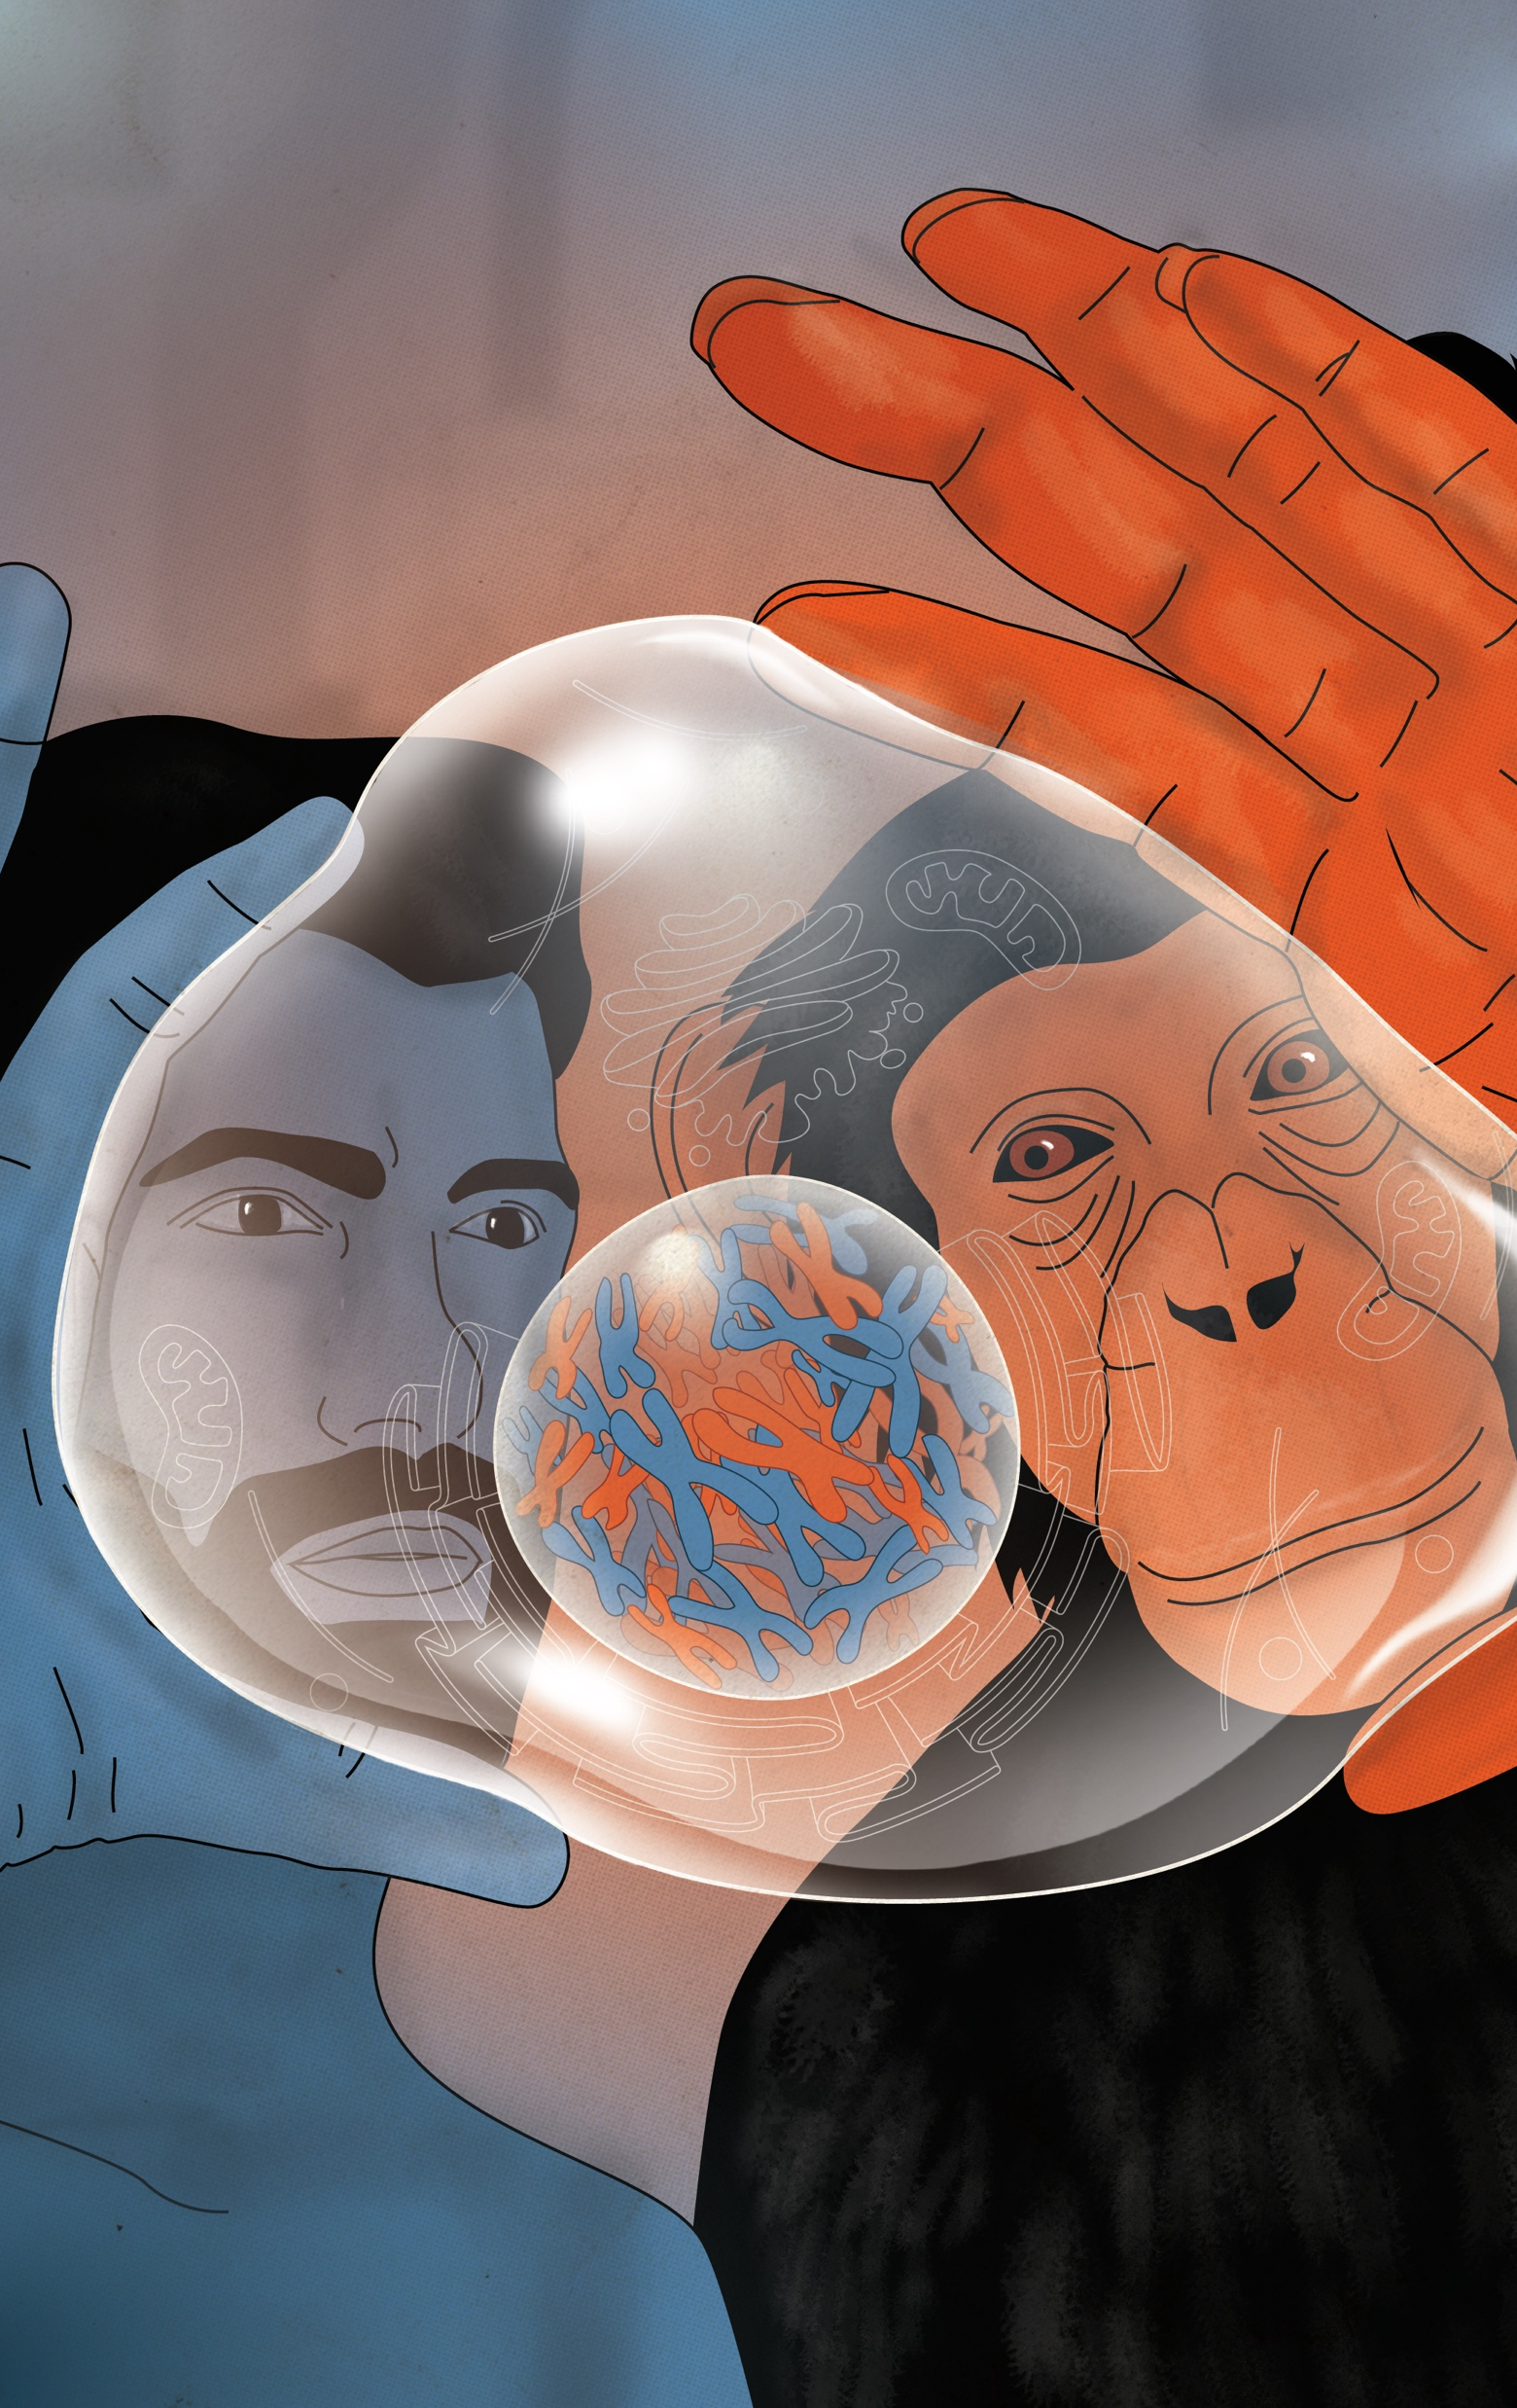
Using hybrids to map the expression changes that shaped disease genes
Expression in hybrid neurons
Alzheimer’s disease genes
Gene 1
Gene 2
Gene 3
Gene 4
Gene 5
…
Gene 100
Signature of adaptive change
Trade-off?
Notes:
So, we will use these human-chimp hybrid cells to identify the evolutionary changes that emerged in disease-causing genes. For example, if we see a case like this, where genes associated with Alzheimer’s disease have become mostly upregulated in humans, this would suggest a signature of selection driving these genes to up-regulation in humans. Perhaps, this reflects a trade-off, where upregulation of this pathway was adaptive, but also exposed us to Alzheimer’s

Slide 8
Using human-ape hybrids to study disease
Cliff-edge theory
Trade-off between adaptation and disease risk
Adaptive change
Fitness
Disease
Gene expression
Notes:
What could this trade-off be? Maybe the increase in the expression of these genes was adaptive and pushed you up the hill, but also closer to the cliff-edge, and then, if the expression increases slightly further due to environmental effects for example, you fall off the cliff and get the disease

Slide 9

Summary
- Human evolution gave rise to many human-specific diseases
- How and why these diseases emerged remains unknown
- Utilize human-ape hybrids to provide insight into the evolutionary forces that shaped disease genes
Gokhman Lab

